Slide 1

































Test data injection / Mocks / Stubs / Unit Testing
Functional / Non Functional
Test Data
Data Preparation
Asses & Setup
App UI
External
Data Selection
Identify & Intelligent sampling
Data Dependencies
Risk Based Testing
User Profile Testing
Random Testing
AUT
Web
Services
Test Execution
BDD
Validation
Automated
Verification
Performance
Manual
Test automation
Reporting
Orthogonal
Array

Slide 2





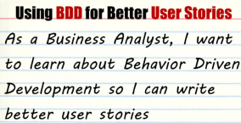



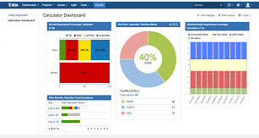


1. Deployment
2. Trigger nightly runs
3. AUT
4. Return Results
5. Utility push to JIRA
SpecRunner/Cucumber Results
6. Xray Dashboards

